Slide 1
MIS 543 Business Data Communications & Networking Fall 2025 Python Boot Camp Part 1
Paul Kealey
kealey@arizona.edu
Office: McClelland Hall 430FF

Slide 2
MIS 543
MIS 543 – Business Data Communication and Networking will have several projects that involve programming the network in Python.
Even though you can learn Python as the class progresses it will be much easier if you learn some basic Python before the semester starts.
That is why we ask you to complete the assignment and attend this short bootcamp.

Slide 3
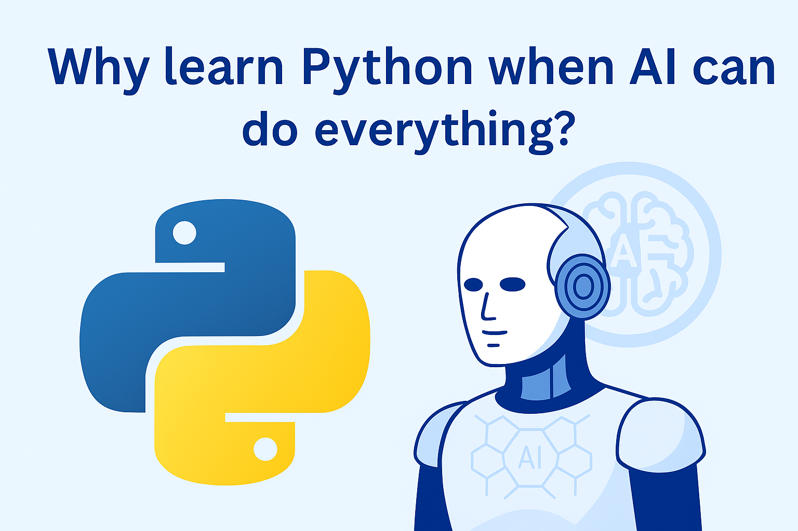

Slide 4
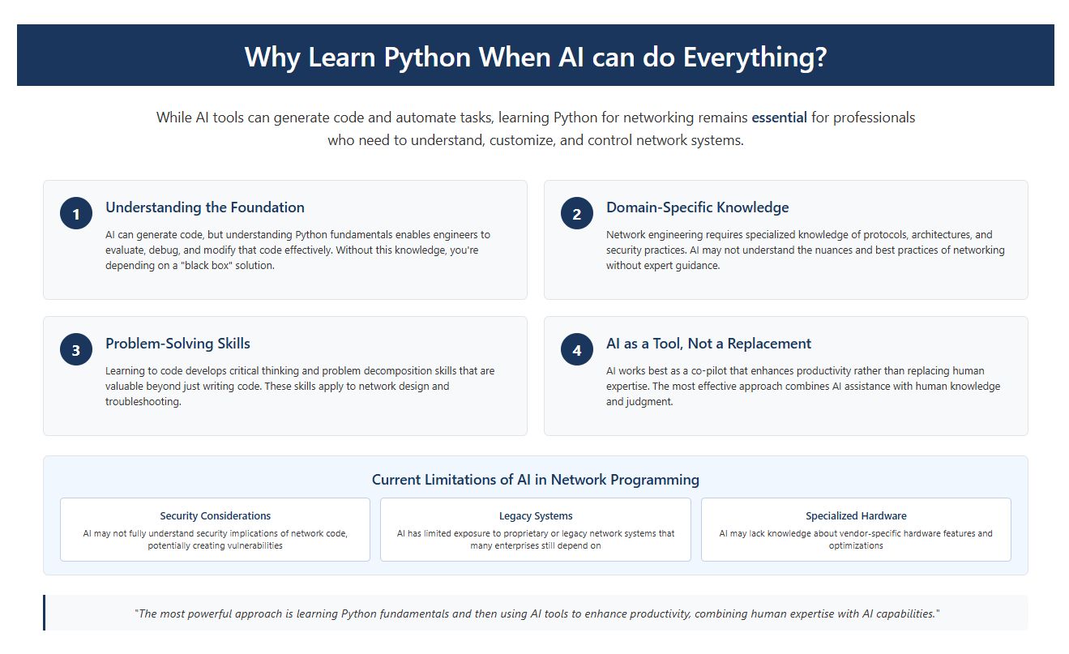

Slide 5
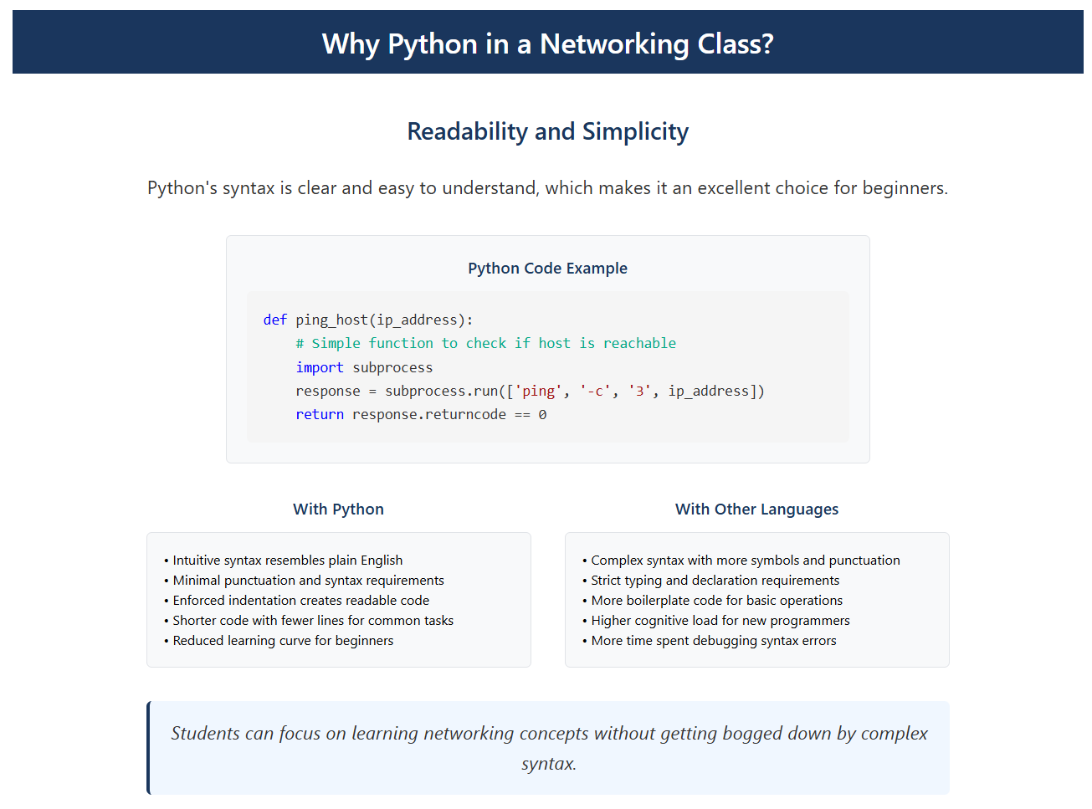

Slide 6
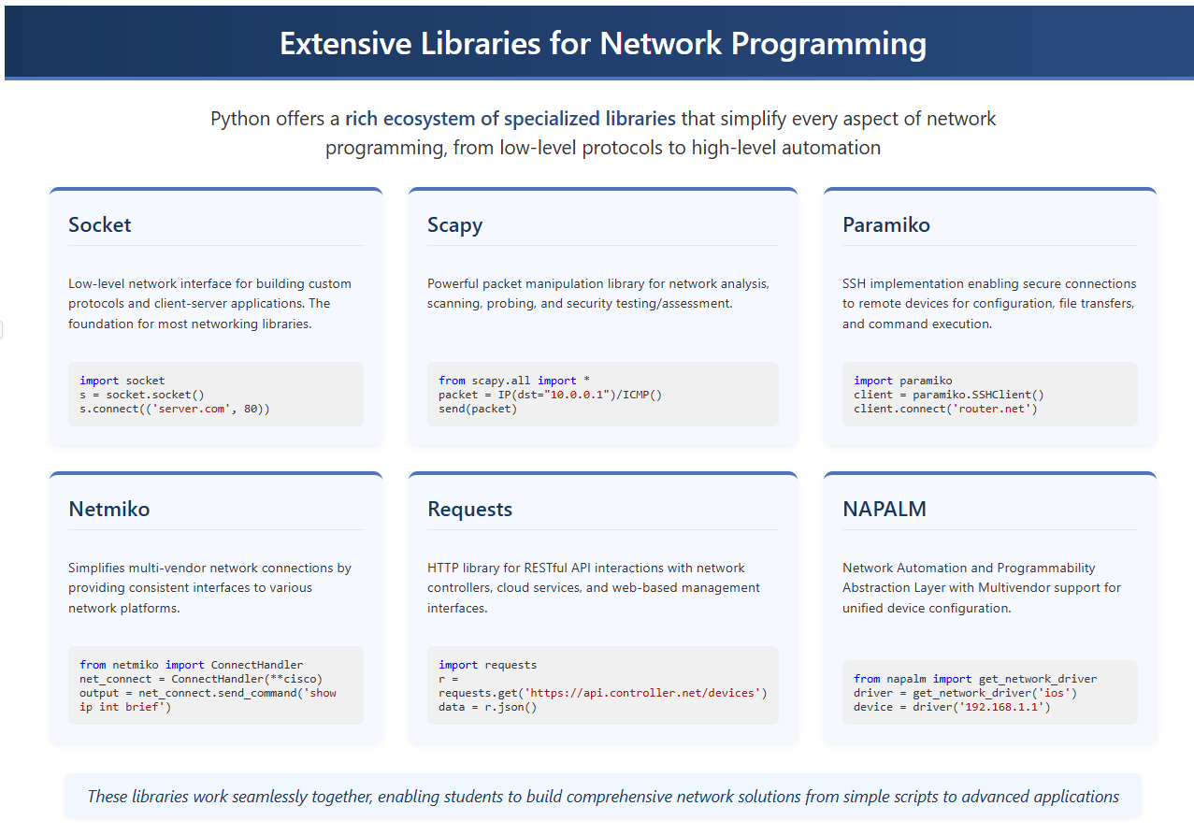

Slide 7
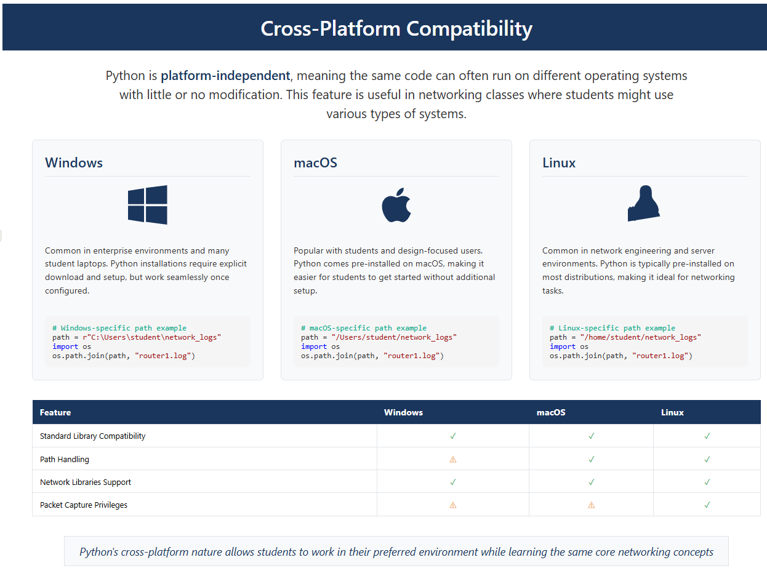

Slide 8
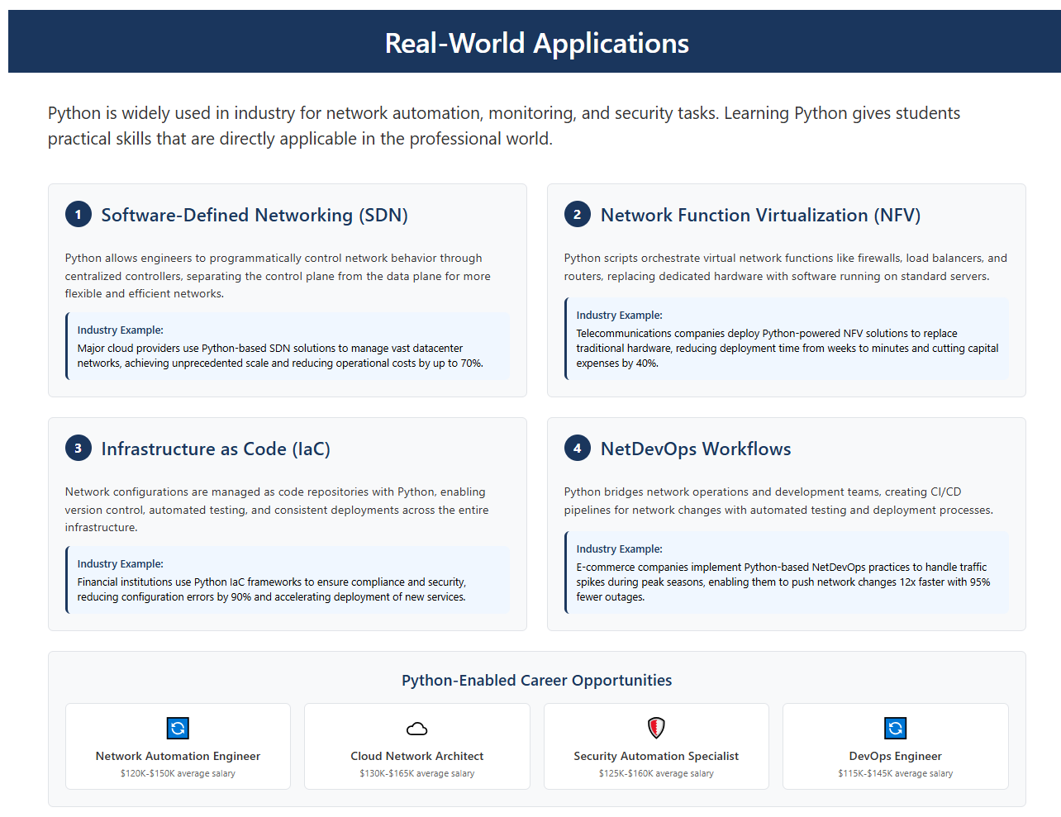

Slide 9
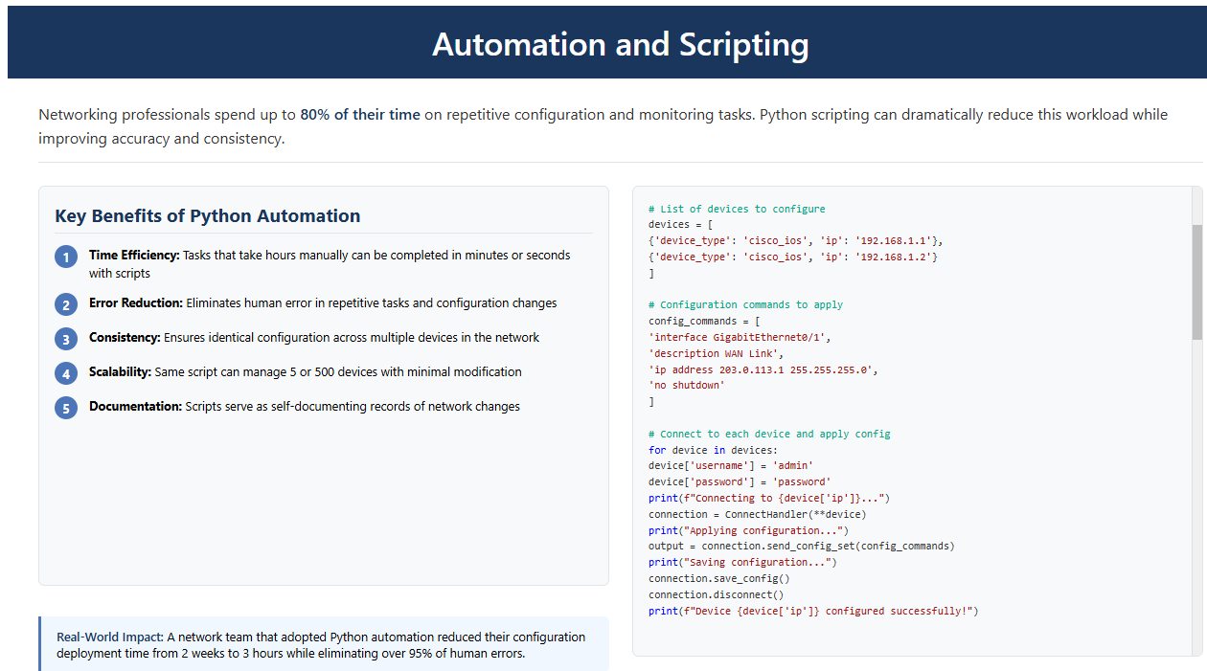

Slide 10
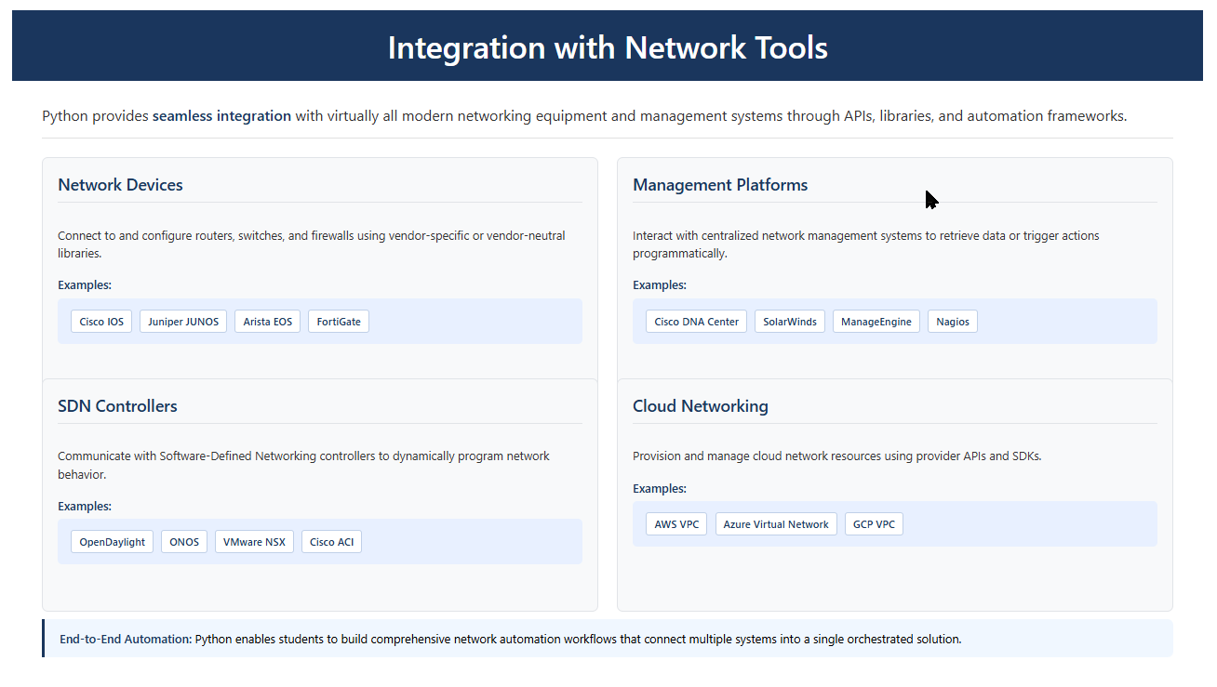

Slide 11
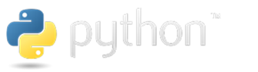
Introduction to Python

Slide 12
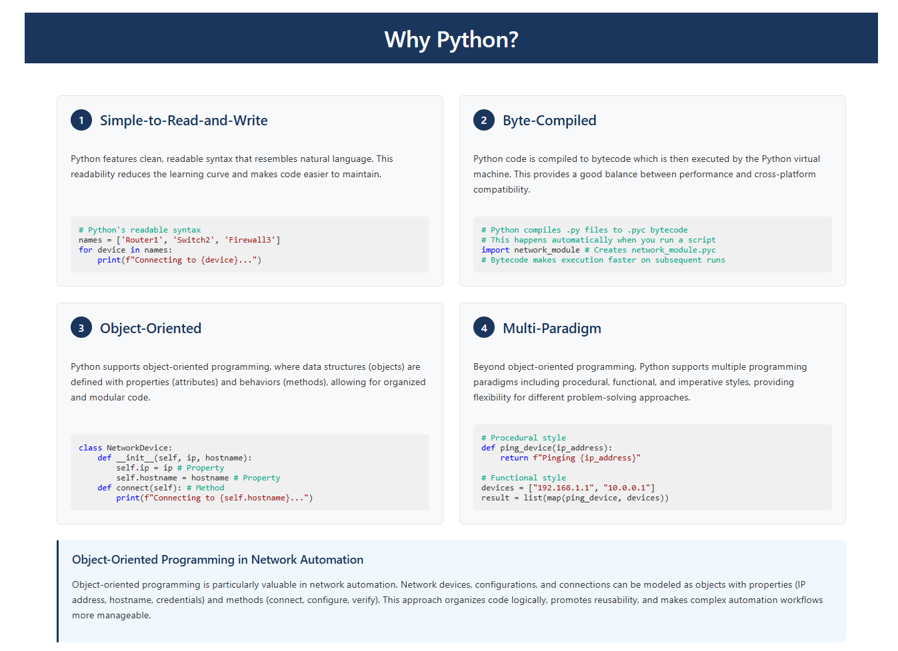
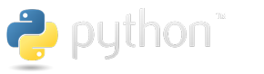

Slide 13
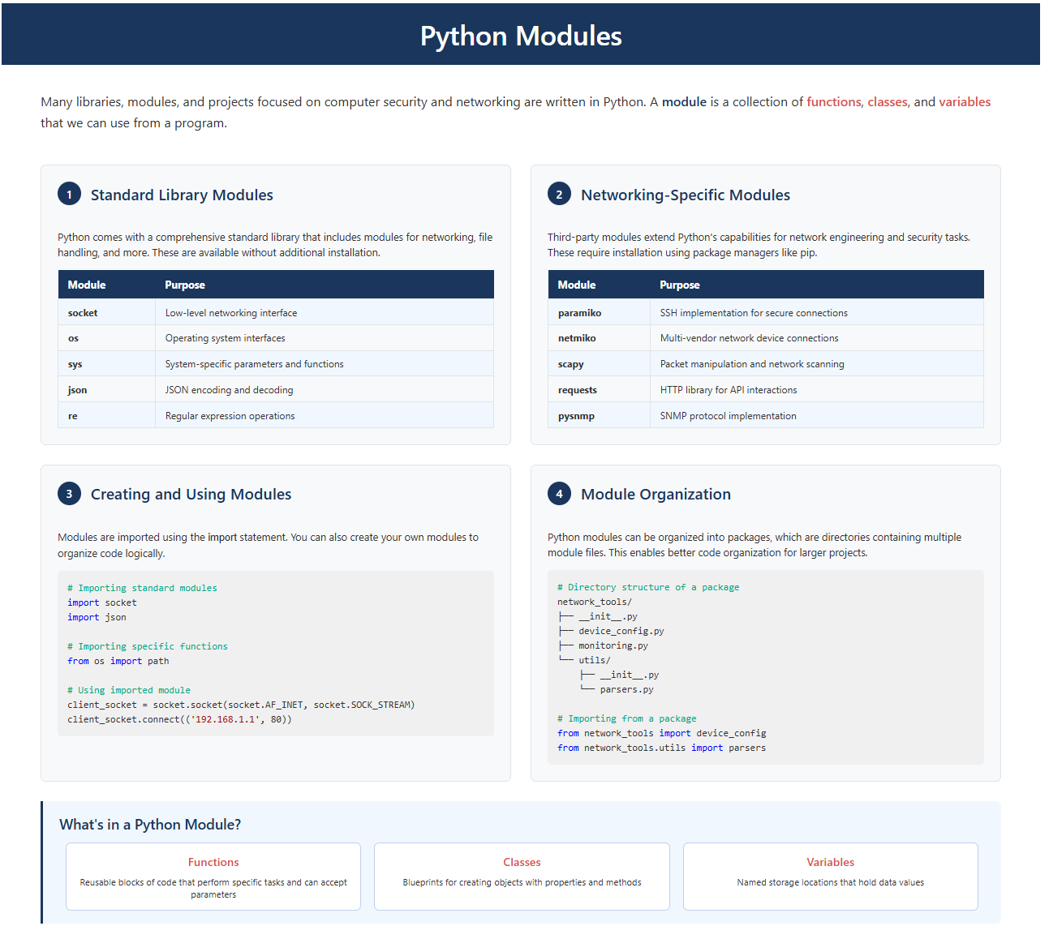

Slide 14
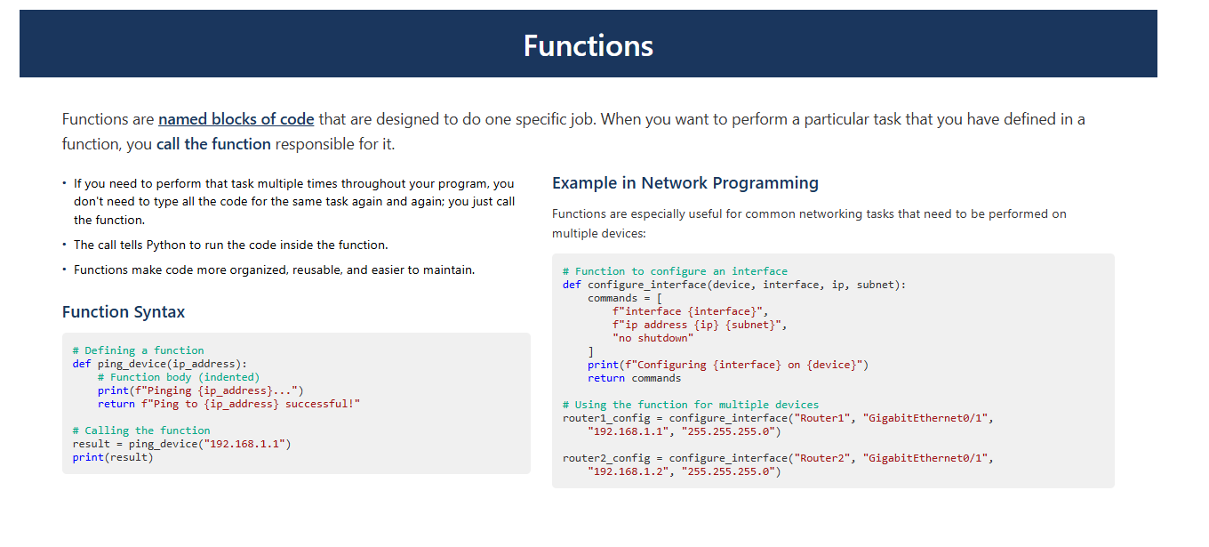

Slide 15
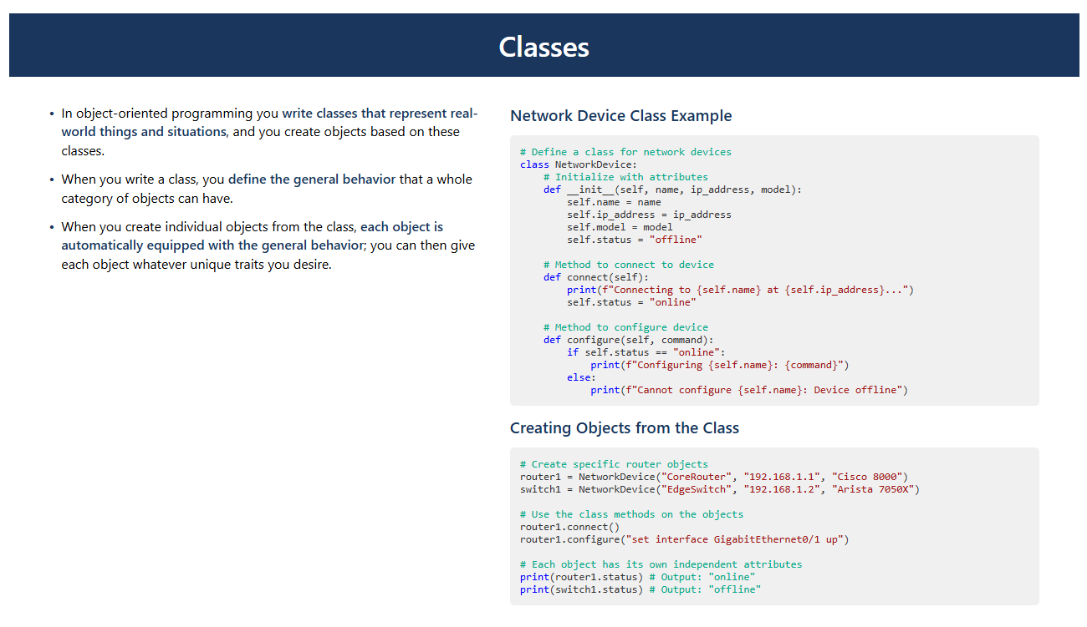

Slide 16
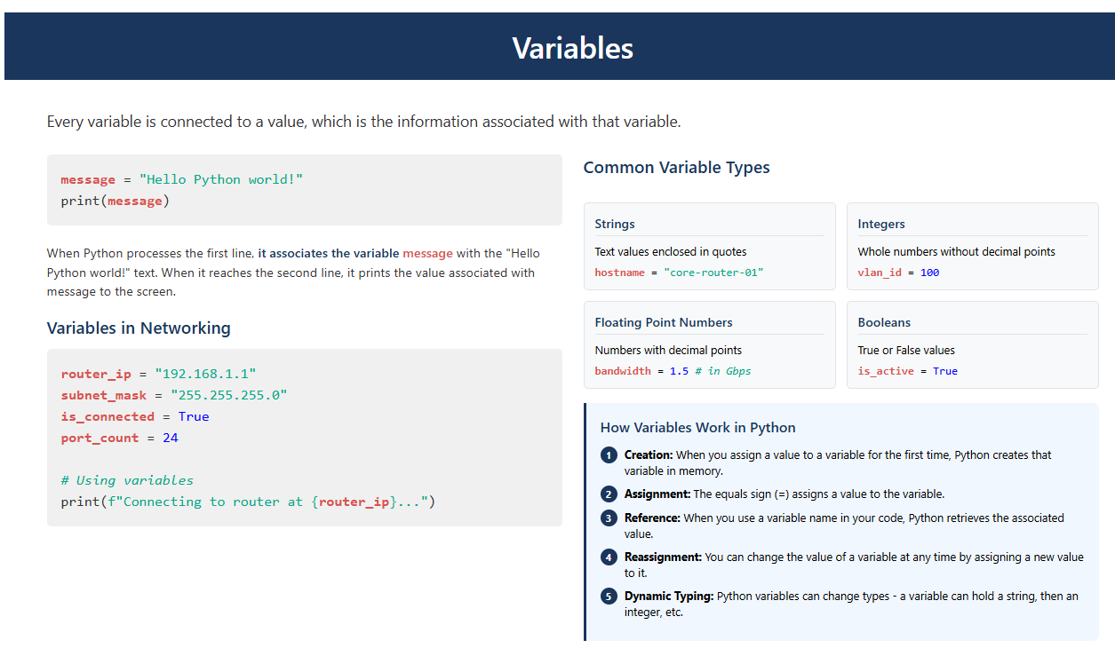

Slide 17
Setting up your Python Environment for the first time

Slide 18
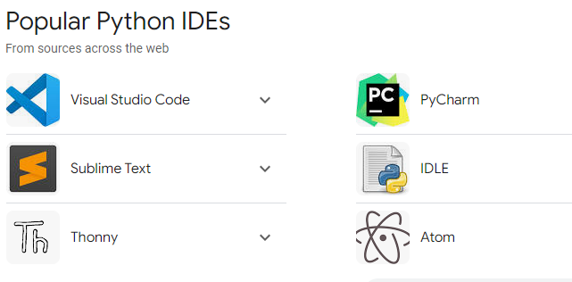
Python IDE
An integrated development environment (IDE) is a software application that combines various tools for software development into a single interface, making it the primary tool for Python development.
A python interpreter is a computer program that converts each high-level program statement into machine code. An interpreter translates the command that you write out into code that the computer can understand.

Slide 19
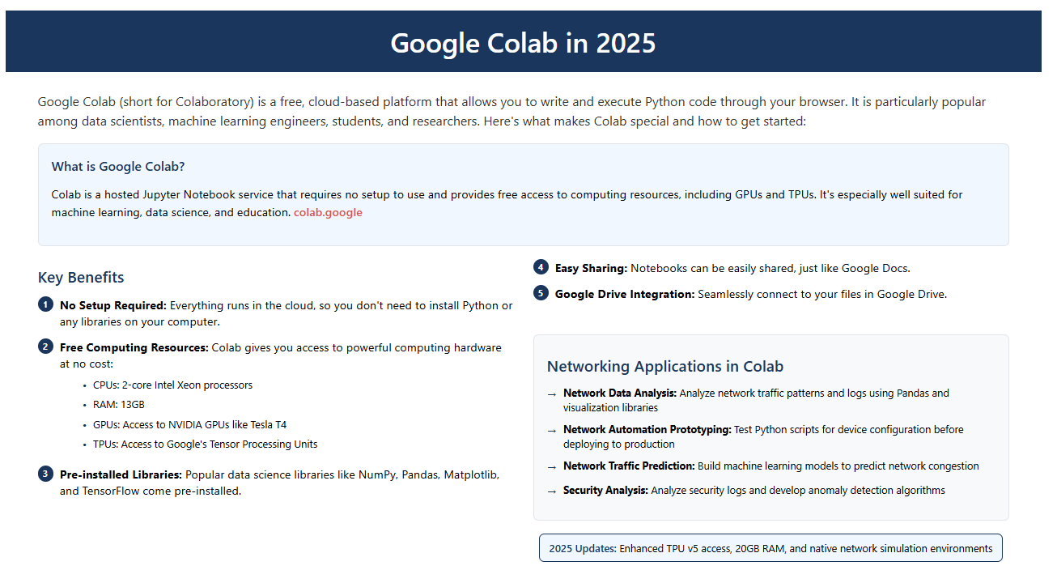

At their core, Tensor Processing Units are hardware accelerators specifically tailored for the high-volume, low-precision computations characteristic of machine learning. Unlike general-purpose processors like CPUs or even the more parallelized GPUs, TPUs are domain-specific, meaning they are optimized for one primary task: matrix operations, also known as tensor calculations. This specialization allows them to perform these operations with significantly higher speed and power efficiency.

Slide 20
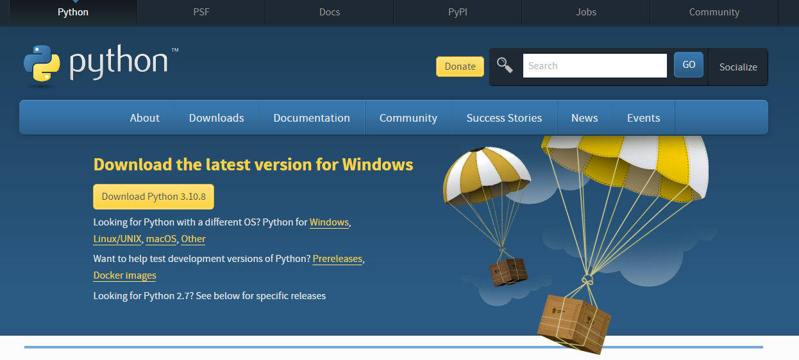
Python
As of August 2025, the latest stable version of Python is Python 3.13 which was released in October 2024.
Python 3.13 includes several improvements and new features over previous versions, including:
Further performance optimizations
Enhancements to type hinting
Improvements to the standard library
Better error messages

Slide 21
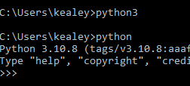
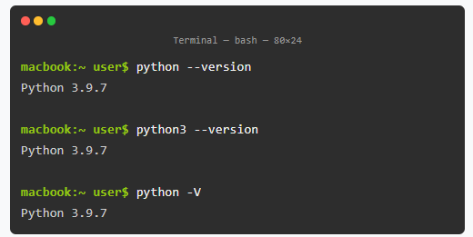
Test your installation
PC – Type python at the command prompt. Make sure you have the latest version.
MAC – type python3 in terminal. Make sure you have version latest version.

Slide 22
Running Python in a Terminal Session
You can now try running snippets of Python code by opening a terminal and typing python3. Enter the following line in the terminal session:
To enter the Python Shell type Python at the command line and hit return.
>>> print("Hello Python interpreter!")
Hello Python interpreter!
>>>
Your message should print directly in the current terminal window. Remember that you can close the Python interpreter by pressing CTRL-D or by entering the command exit().

Slide 23
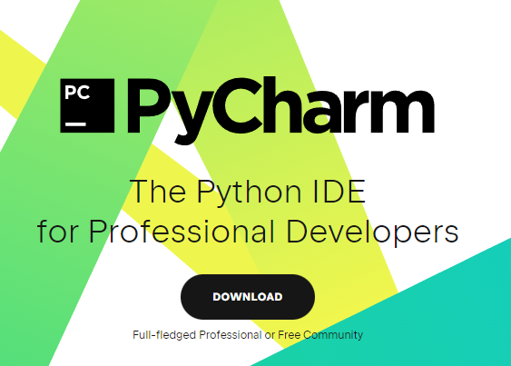
Install PyCharm IDE
An integrated development environment (IDE) is a software application that helps programmers develop software code efficiently. It increases developer productivity by combining capabilities such as software editing, building, and testing.
PyCharm is a professional Python IDE
A collection of tools out of the box:
an integrated debugger and test runner;
Python profiler;
a built-in terminal;
and integration with major VCS and built-in Database Tools.

Slide 24
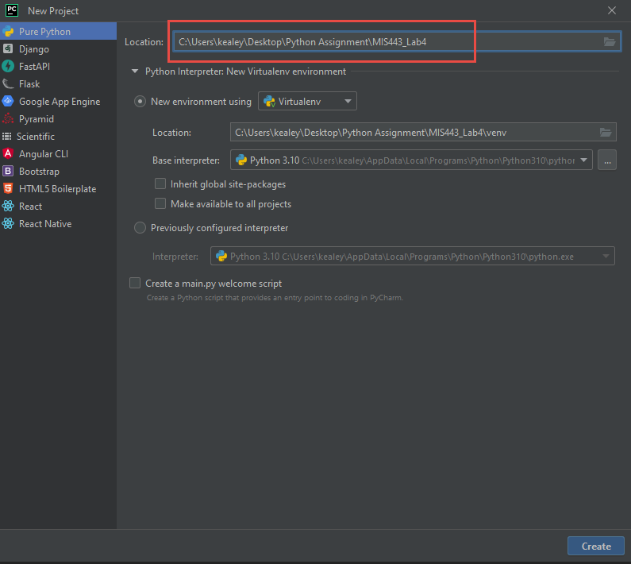
Create a Python Project
Create a folder on your computer called mis543
You will store all your work in this folder.
Open PyCharm
Click on the New Project Button
Open PyCharm and create a new project
Change the location to point to your mis543 folder.

Slide 25
Run the sample file
Run the sample file main.py
Add the sample code “Your Name Here” with your name
Run the script.
Mac Control click the file and run
PC Right click and run the file.

Slide 26
Create a Python Program
Open PyCharm, and save an empty Python file (File - New – Python FIle) called hello_world.py in your mis443_lab4 folder.
The extension .py tells PyCharm that the code in your file is written in Python, which tells it how to run the program and highlight the text in a helpful way.
After you’ve saved your file, enter the following line in the text editor:
print(“My first MIS 443 python program!")

Slide 27
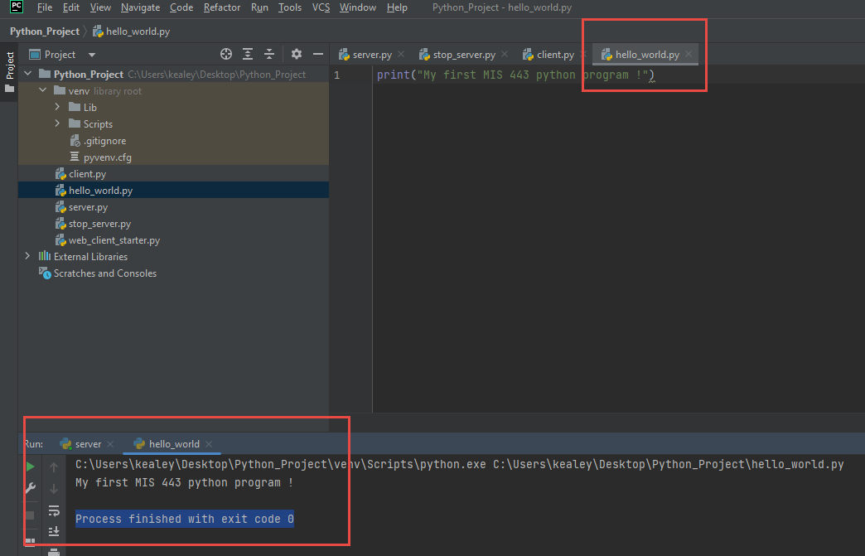
Run Your Program
Right click the file tab and select run. This will run your Python program and show you the output. Process finished with exit code 0 means there were no errors in your code.

Slide 28
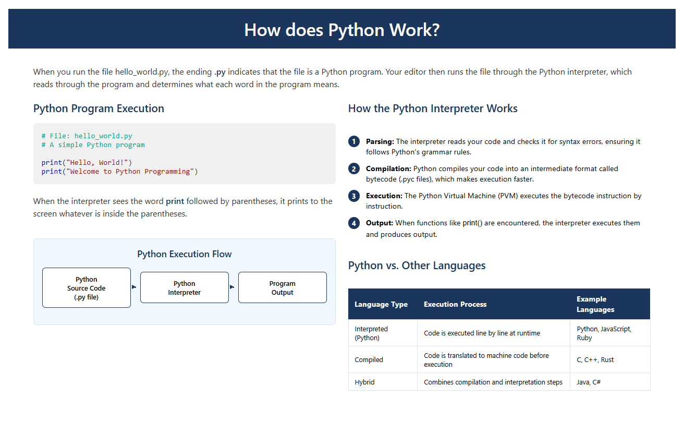

Slide 29
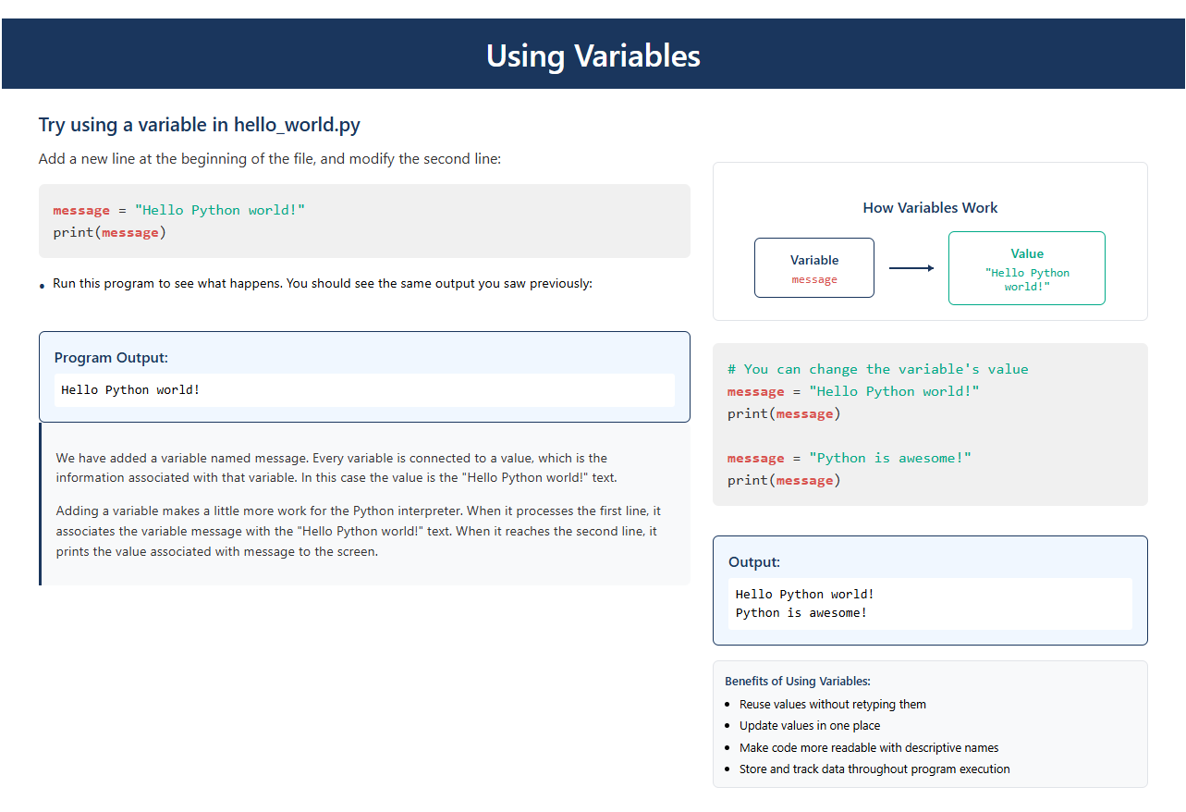

Slide 30
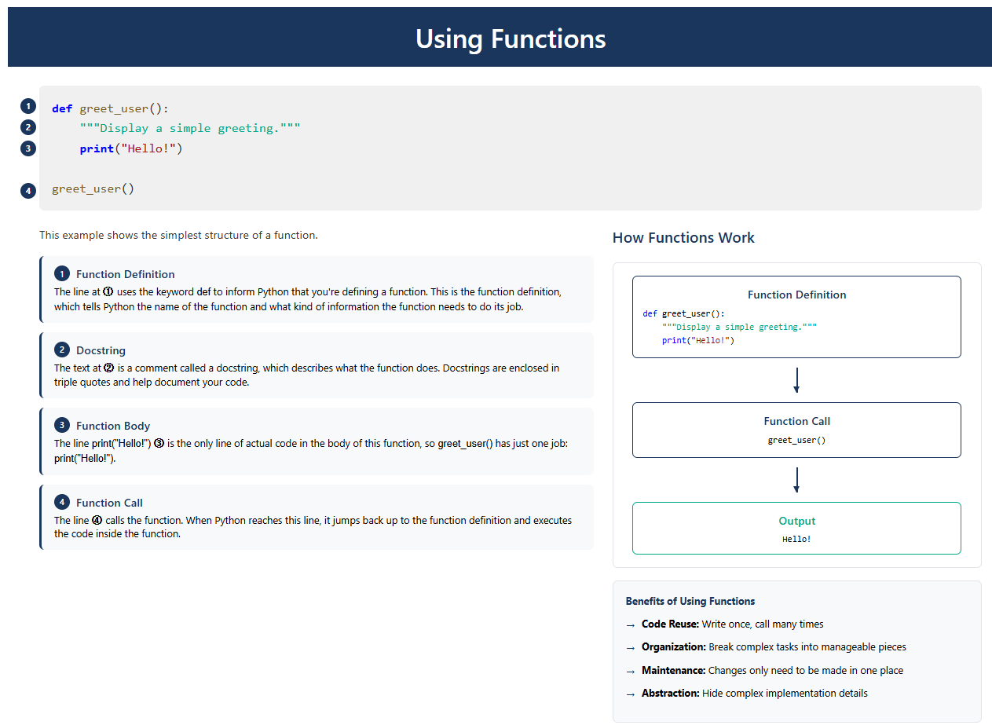

Slide 31
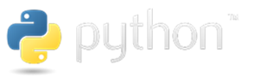
The Socket Module

Slide 32
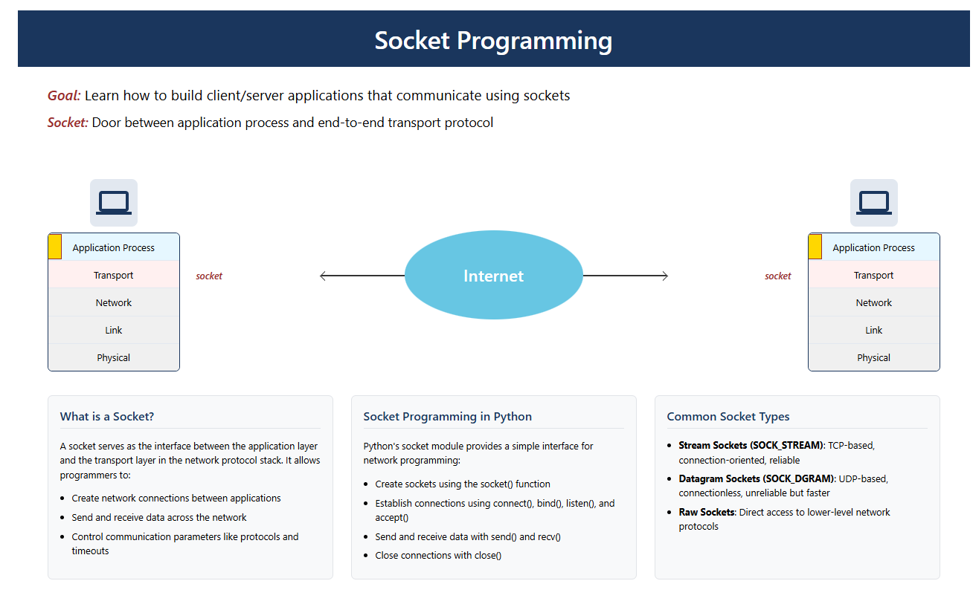

Slide 33
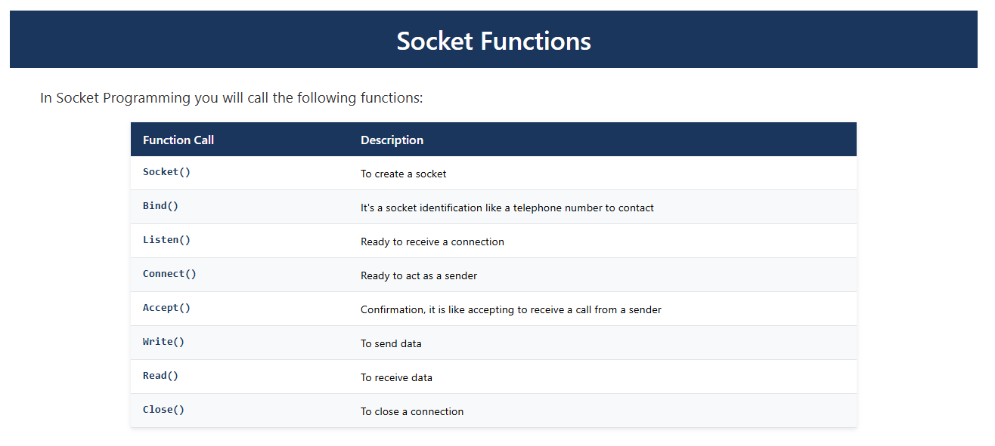

Slide 34
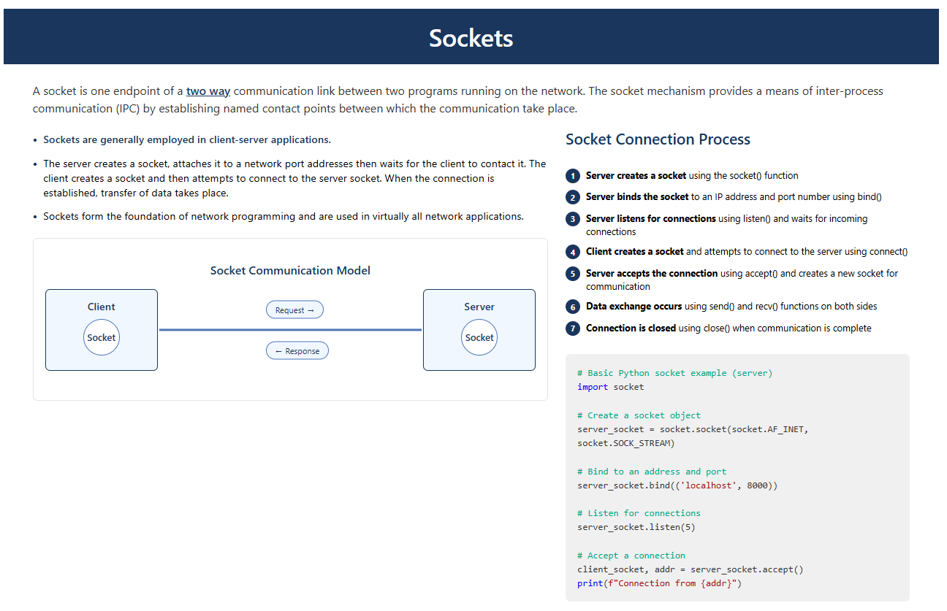
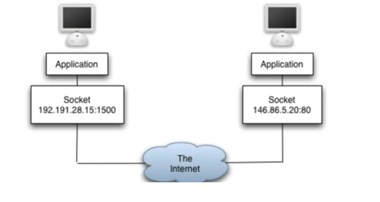

Slide 35
Types of Sockets
There are two types of Sockets: the datagram socket and the stream socket.
UDP Datagram Socket : This is a type of network which has connection less point for sending and receiving packets. It is similar to mailbox. The letters (data) posted into the box are collected and delivered (transmitted) to a letterbox (receiving socket).
TCP Stream Socket In Computer operating system, a stream socket is type of interprocess communications socket or network socket which provides a connection-oriented, sequenced, and unique flow of data without record boundaries with well defined mechanisms for creating and destroying connections and for detecting errors. It is similar to phone. A connection is established between the phones (two ends) and a conversation (transfer of data) takes place.

Slide 36
The Socket Module
The socket module exposes all of the necessary methods to quickly write TCP and UDP client and server network applications.
Sockets are commonly used for client and server interaction. Typical system configuration places the server on one machine, with the client/s on other machines. The clients connect to the server, exchange information, and then disconnect.
A socket has a typical flow of events. In a connection-oriented client-to-server model, the socket on the server process waits for requests from a client.
To do this, the server first establishes (binds) an address that clients can use to find the server. When the address is established, the server waits for clients to request a service.
The client-to-server data exchange takes place when a client connects to the server through a socket.
The server performs the client's request and sends the reply back to the client.

Slide 37
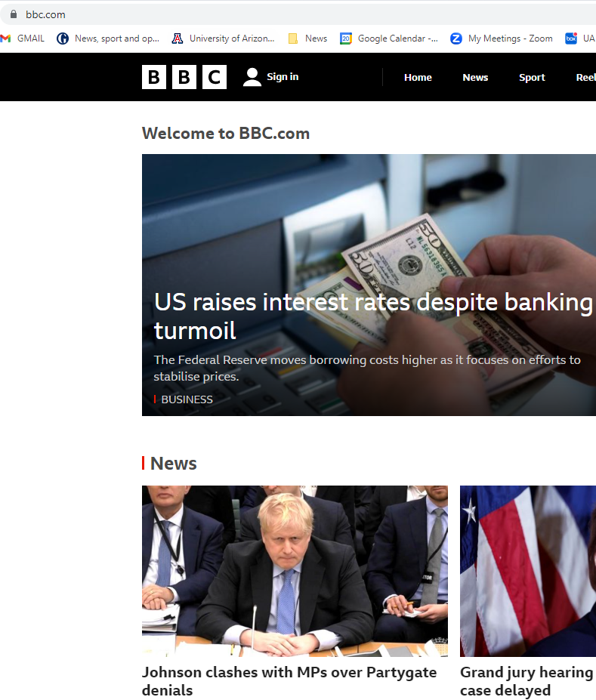
Creating a Socket – TCP Client
When you click on the link that brought you to the BBC page, your browser did something like the following:
# create an INET, STREAMing socket
s = socket.socket(socket.AF_INET, socket.SOCK_STREAM)
# now connect to the web server on port 443 - the normal https port
s.connect(("www.bbc.com", 443))
When the connect completes, the socket can be used to send in request for the text of the page. The same socket will read the reply

Slide 38
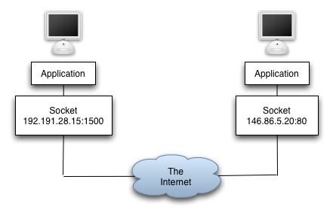
Creating a Socket – TCP Server
What happens in the web server is a bit more complex. First, the web server creates a “server socket”:
# create an INET, STREAMing socket
serversocket = socket.socket(socket.AF_INET, socket.SOCK_STREAM)
# bind the socket to a public host, and a well-known port
serversocket.bind((socket.gethostname(), 443))
# become a server socket
serversocket.listen(5)

Slide 39
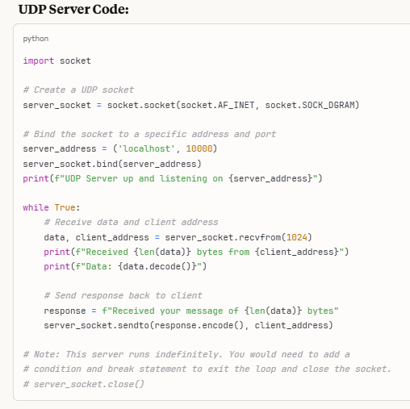
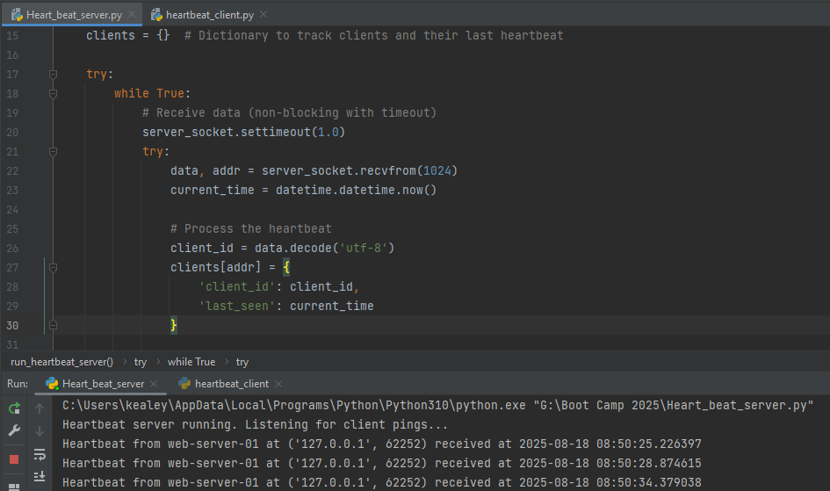
Creating a Socket – UDP Server
Import socket library
Create UDP socket: socket(AF_INET, SOCK_DGRAM)
Bind socket to address and port: bind(('IP_ADDRESS', PORT))
Receive data: data, addr = recvfrom(BUFFER_SIZE)
Process received data
Send response: sendto(response, addr) [optional]
Close socket: close()
UDP Heartbeat Application Example. Note: Unlike TCP, UDP is connectionless - no accept() or listen()

Slide 40
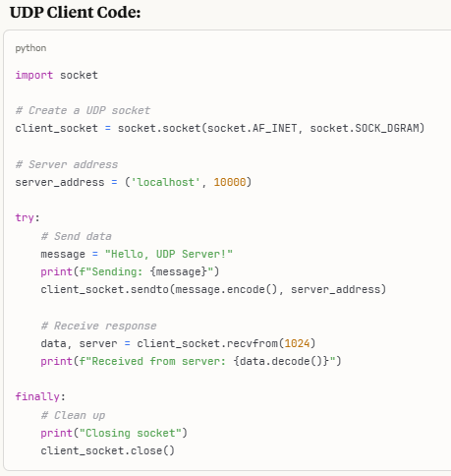
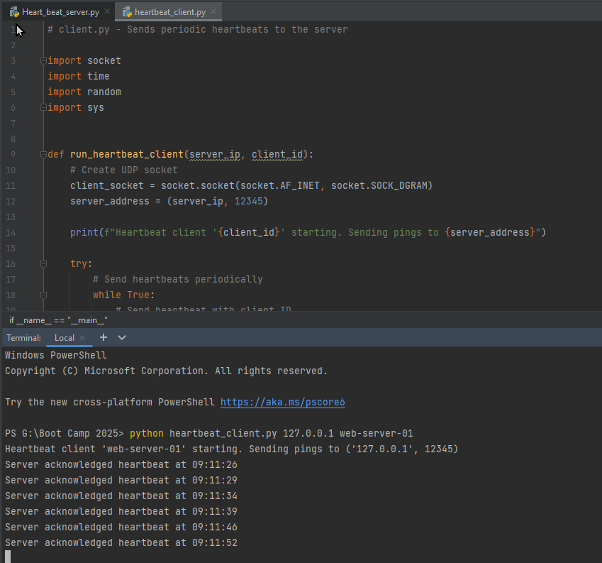
Creating a Socket – UDP Client
Import socket library
Create UDP socket: socket(AF_INET, SOCK_DGRAM)
Prepare data for transmission
Send data: sendto(data, ('SERVER_IP', PORT))
Optionally receive response: data = recvfrom(BUFFER_SIZE)
Process response data (if needed)
Close socket: close()
UDP Heartbeat Application Example. Note: No connection establishment required - just send directly to server

Slide 41
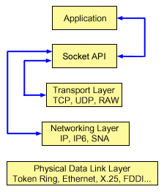
Network Model
The socket APIs are located in the network model between the application layer and the transport layer.
The socket APIs are not a layer in the network model. Socket APIs allow applications to interact with the transport or networking layers of the internetmodel. The arrows in the following figure show the position of a socket, and the communication layer that the socket provides.
© Copyright IBM Corporation 2002, 2015

Slide 42
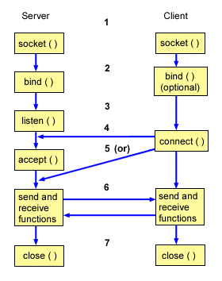
Flow of events for a socket
The socket() API creates an endpoint for communications and returns a socket descriptor that represents the endpoint.
When an application has a socket descriptor, it can bind a unique name to the socket. Servers must bind a name to be accessible from the network.
The listen() API indicates a willingness to accept client connection requests. When a listen() API is issued for a socket, that socket cannot actively initiate connection requests. The listen() API is issued after a socket is allocated with a socket() API and the bind() API binds a name to the socket. A listen() API must be issued before an accept() API is issued.
The client application uses a connect() API on a stream socket to establish a connection to the server.
The server application uses the accept() API to accept a client connection request. The server must issue the bind() and listen() APIs successfully before it can issue an accept() API.
When a connection is established between stream sockets (between client and server), you can use any of the socket API data transfer APIs. Clients and servers have many data transfer APIs from which to choose, such as send(), recv(), read(), write(), and others.
When a server or client wants to stop operations, it issues a close() API to release any system resources acquired by the socket.
© Copyright IBM Corporation 2002, 2015

Slide 43
Projects in MIS 543 using Python
For this class you will learn the basics of socket programming for TCP and UDP connections in Python: how to create a socket, bind it to a specific address and port, as well as send and receive a HTTP packet. You will also have some hands-on experience of HTTP header format. The learning objectives are as follows:
Get familiar with python socket programming
Introducing sockets in Python
Construct and modify HTTP request and response
Implementing a HTTP server in Python
Implementing a HTTP client in Python
Implementing a UDP server in Python
Implementing a UDP client in Python
Creating and Testing Protocols

Slide 44
Part 2 Tomorrow
Part Two will break down the problem that was assigned to you. Colab with AI-Powered tools
Questions?
Paul Kealey
kealey@arizona.edu
Office: McClelland Hall 430FF

